Slide 1
Automated Handwriting Recognition of English and Native Indian Languages with Deep Learning
Project by
Souporno Ghosh
Soumya Nasipuri
Rahul Roy
Sharanya Saha
Under the Guidance of
Smt Jaya Paul

Slide 2
Motivation
Shortage of Research in Native Indian Language Recognition
Authentication of Manuscripts
Forensic Analysis and Law Enforcement
Plagiarism Verification

Slide 3
Software Used
Python 3.8
TensorFlow 2.0
Keras
NumPy
Pandas
Mat Plot Lib
PyPlot
SeaBorn
VGG16

Slide 4
Hardware Used
HP Pavilion with Intel i5 Quad-Core, Integrated Graphics Card, 8GB RAM
Dell G3 with 2.6GHz Hexa-Core Intel i7 Processor, Integrated Graphics Card, 8GB RAM
Asus Vivibook 2GHz Quad-Core AMD Ryzen 5 Processor, Integrated Graphics Card, 8GB RAM

Slide 5
Significance of the Hardware
RAM and Processor for Processing Speed
GPU Might Help!

Slide 6
Background
Works on Image Recognition and CNN
ImageNet classification with deep Convolutional Neural Networks
Very Deep Convolutional Networks for Large-Scale Image Recognition
Works on Character Recognition
Automatic Visual Features for Writer Identification: A Deep Learning Approach
Handwritten Character Recognition of South Indian Scripts: A Review
A High Performance Domain Specific Ocr For Bangla Script
Bangla character recognition based on Mobilenet v1 and Inception v3
CNN implementation based on Bangla numeral character recognition
Works on Writer Recognition
Offline writer identification using convolutional neural network activation features
Writer identification using an HMM-based handwriting recognition system: To normalize the input or not
Offline Text-Independent Writer Identification Based on Scale Invariant Feature Transform

Slide 7
Summary of Present Work

Slide 8
Collection of Data Set
121 volunteers
3 Language: English, Hindi, Bangla
Handwritten Passage
Bangla Text only in our project

Slide 9
Preparation of Data Set
Noise Eliminated
Word-sized Segments
Folder Organisation
Each DataSet has 20 Folders
Every Folder has Data for 2 Authors
5 Sets of Data for Each Author Pair
3 Training Sets and 2 Testing Sets
Tag Image File Format
Format: <Author Code>_<Set Number>_<Image Number>
5 Data Sets in Total

Slide 10
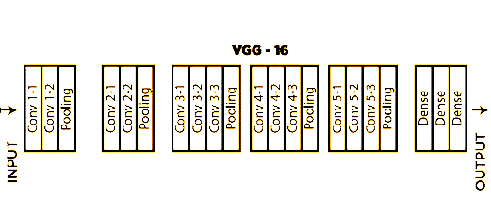
About VGG16 Model
Proposed by Simonyan and Zisserman in 2014
92.7% accuracy with the ImageNet Database
16 Neural Network Layers
13 Convolutional Networks
3 Dense Networks
Takes 224 x 224 pixel Images with RGB as an Input

Slide 11
Architecture of VGG16 Model
Input: 224 x 224 RGB Images
2 ConvNets with 64 filters and ReLU Activation Function; Output is MaxPooled
2 ConvNets with 128 filters and ReLU Activation Function; Output is MaxPooled
3 ConvNets with 256 filters and ReLU Activation Function; Output is MaxPooled
3 ConvNets with 512 filters and ReLU Activation Function; Output is MaxPooled
3 ConvNets with 512 filters and ReLU Activation Function; Output is MaxPooled
2 Dense Neural Nets with 4096 units and ReLU Activation Function
1 Dense Neural Net with 1000 units and SoftMax Activation Function
Output: Category (1000 in the ImageNet Database)

Slide 12
Challenges of VGG16
Slow to Train
Big Size

Slide 13
Feature Extraction

Slide 14
Program Walkthrough

Slide 15
What comes next

